Slide 1


Model Utilities
UNCLASSIFIED
Todd Steissberg
U.S. Army Engineer Research and Development Center, Environmental Laboratory
CE-QUAL-W2 Workshop, 2024
July 08 – 09, 2024
Environmental Systems
Modeling Team
UNCLASSIFIED

Slide 2
Presentation Overview
We will cover the most important utilities included in the CE-QUAL-W2 v45 download:
Version 4.5
Waterbalance
W2tools post-processor
Control File Version Converter
Excel Macro
Previous versions
W2Control GUI
Features under development
Control file parser
Python .xlsm to .csv converter

Slide 3
Water Balance Utility
Waterbalance.exe is one of the most important W2 utilities:
Calculates ungauged flows by comparing the stages calculated by W2 at a flow control structure such as a dam or gate, with observed stages from a real-life gage.
Closely resembles the ungauged flow utility in HEC-RAS.
From the Model Utilities user-manual:
The water balance utility can be used for lakes and reservoirs in which water surface elevations are a function of inflows and controlled outflows from the system. The utility computes the flows necessary to match observed water surface elevations (typically taken at the dam) and outputs them to the qwb.opt file. This file is composed of a Julian date and an inflow (m3 sec-1 ).

Slide 4
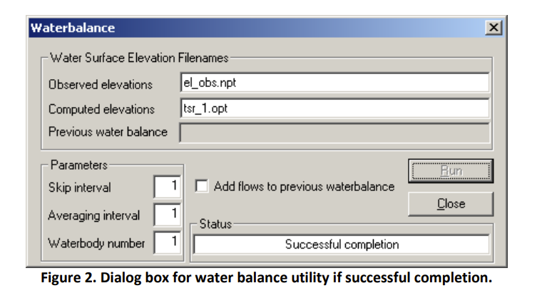
Water Balance Utility

Slide 5
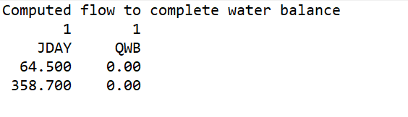
Water Balance Utility – How to adjust the model after running
Iterative Process: We re-run the water balance utility with added inflows each time, producing an output file resembling the illustration below:
Computed flows can be negative, indicating underestimated outflow or overestimated inflow.
Inflows are typically added as distributed inflow, though not always the most accurate.
It is good to run sensitivity analysis on different ways to add/subtract flows.
Any additional flows need to have associated temperature and WQ concentrations.
Subtracted flows will have temperature and WQ concentrations equal to cell from which flows are removed.

Slide 6
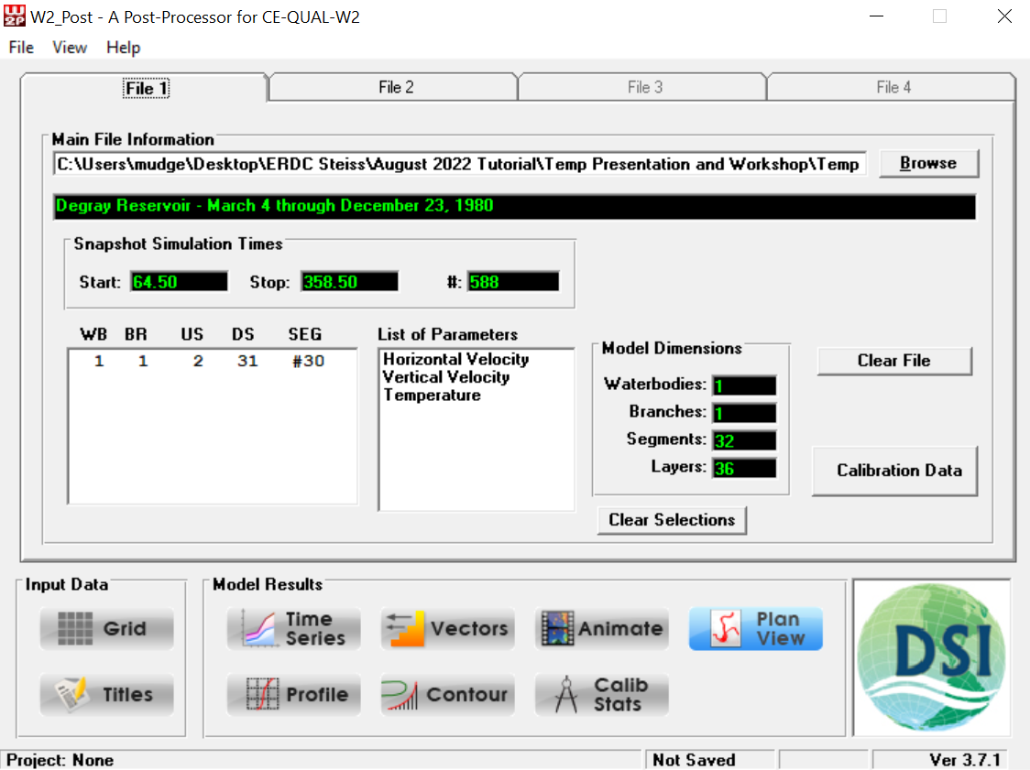
W2tools Post-Processor
W2_Post is a CE-QUAL-W2 post-processing tool created by DSI which reads in a binary file.
The name of the binary file is specified in the W2 control file.
This binary file contains nearly all data generated during the model run.

Slide 7
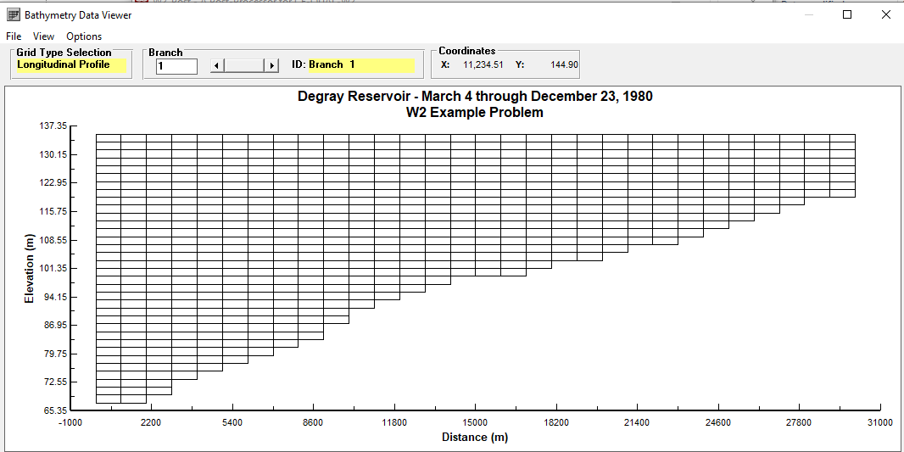
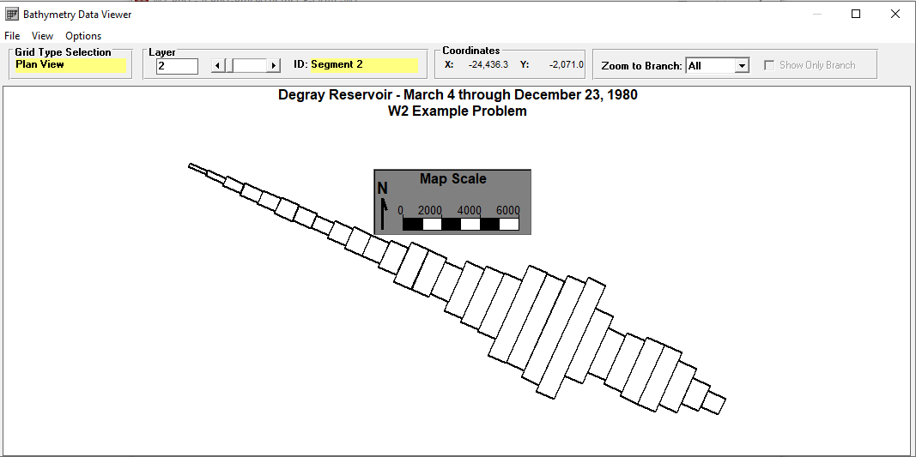
Bathymetry Viewer

Slide 8
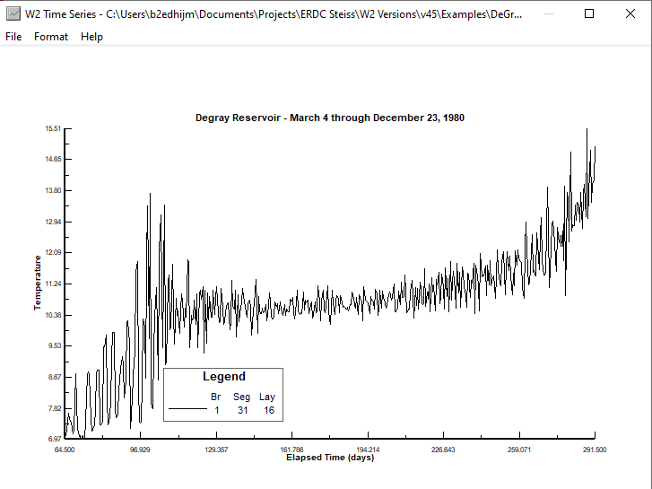
Temperature Time Series – Example View

Slide 9
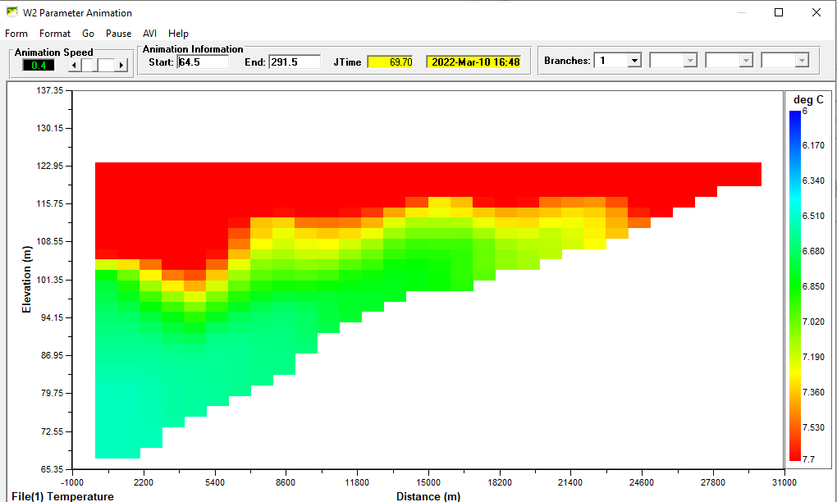
Contour Plotting and Animations

Slide 10
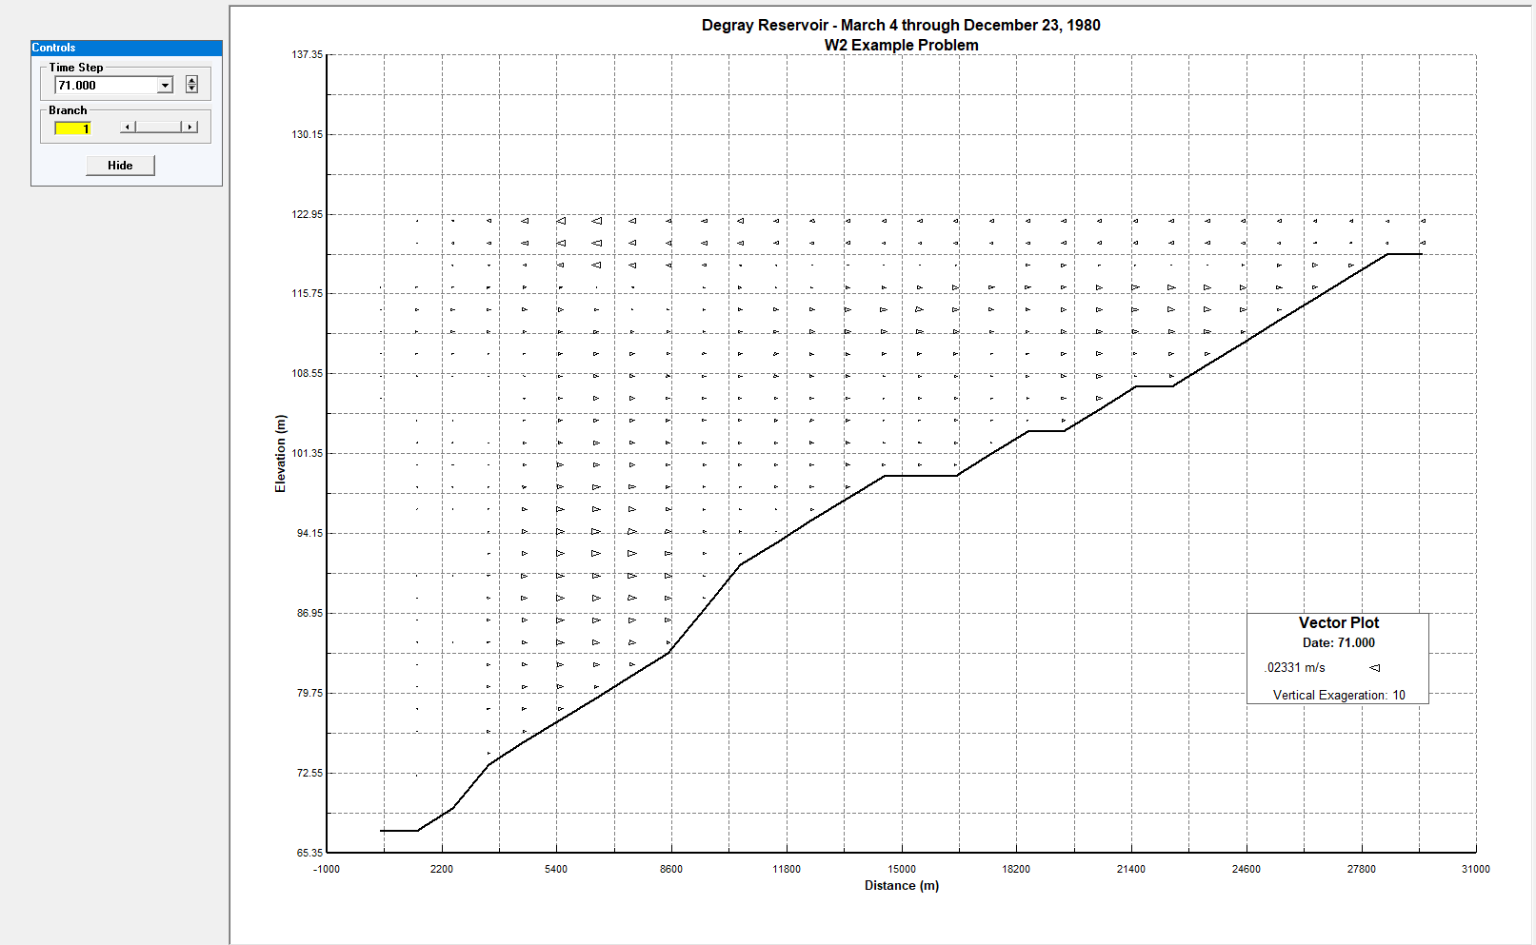
Vector Field Plotting

Slide 11
Output Visualization Future Work
Visualizing Python-based output using built-in plotting tools.
Using YAML configuration files, essentially streamlining the organization of output files and making them easy for humans to read
Making output compatible with USACE security settings
A case-study of these tools will be presented following this lecture.

Slide 12
Control File Converter, from v3.7– 4.2 to v4.5
Feature allows conversion of legacy models to version 4.5.
Different model versions produce slightly different outputs.
Additional details will be offered in tomorrow’s workshop.

Slide 13
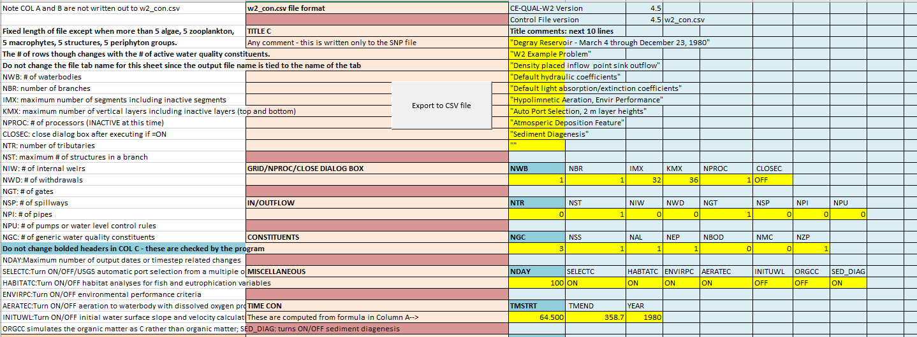
Excel Macro - .xlsm to .csv
This visual basic macro in Excel allows us trim the heavily annotated .xslm file to an input file readable by the model:
The separation between the user-interface and .csv file enables the user to create and save many different model set-ups, but only one input file.
Additionally, a python script based on the ‘pandas’ module can serve this function, as macros are blocked by security settings on some USACE computers.

Slide 14
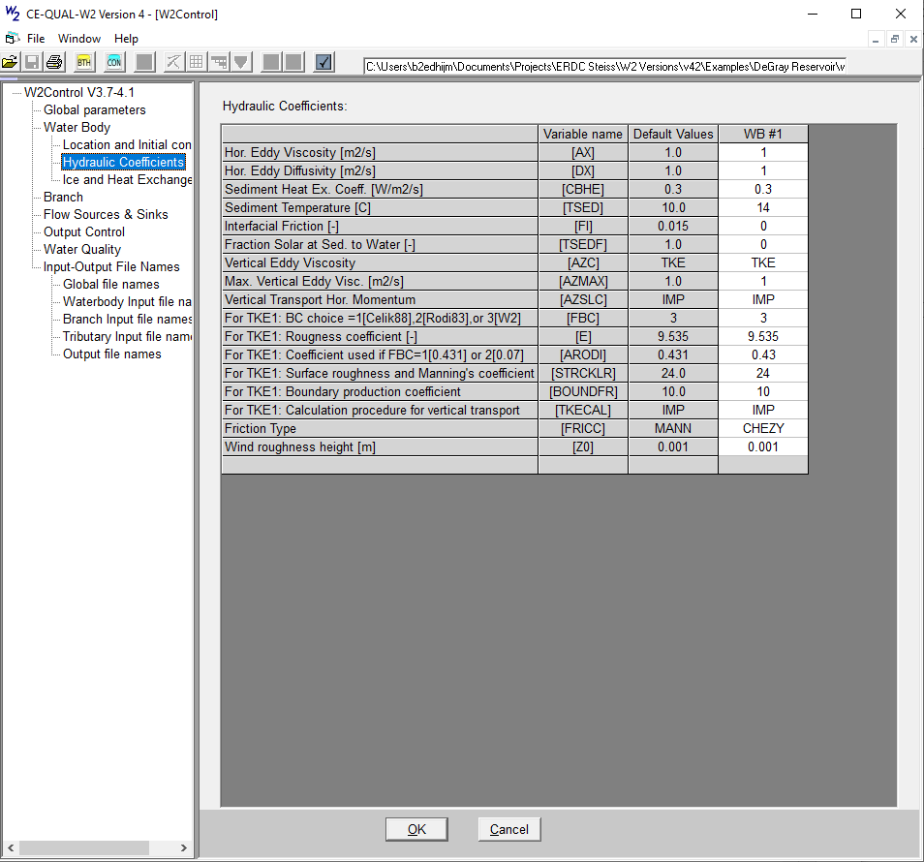
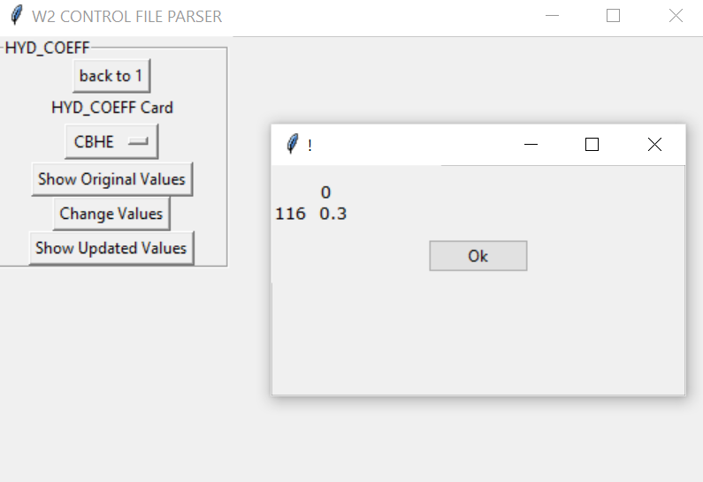
W2Control GUI
The interface prior to the .xlsm file absorbs the .npt file:
A Python tool under development will move the control file .csv in a similar way to the W2Control GUI:s:

Slide 15

Questions?

